Slide 1



DataSpark: Illuminating Insights for Global Electronics
View in Power BI
Last data refresh:
10/2/2024 8:14:07 PM UTC
Downloaded at:
10/2/2024 8:15:38 PM UTC

Slide 2
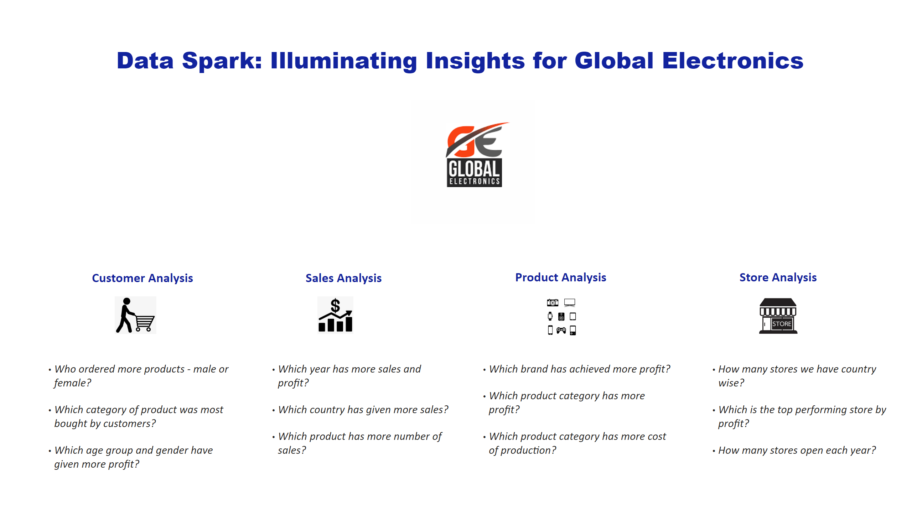
Home
Notes:
textbox
No alt text provided
image
No alt text provided
textbox
No alt text provided
textbox
No alt text provided
textbox
No alt text provided
textbox
No alt text provided
image
No alt text provided
image
No alt text provided
image
No alt text provided
image
No alt text provided
textbox
No alt text provided
textbox
No alt text provided
textbox
No alt text provided
textbox
No alt text provided

Slide 3
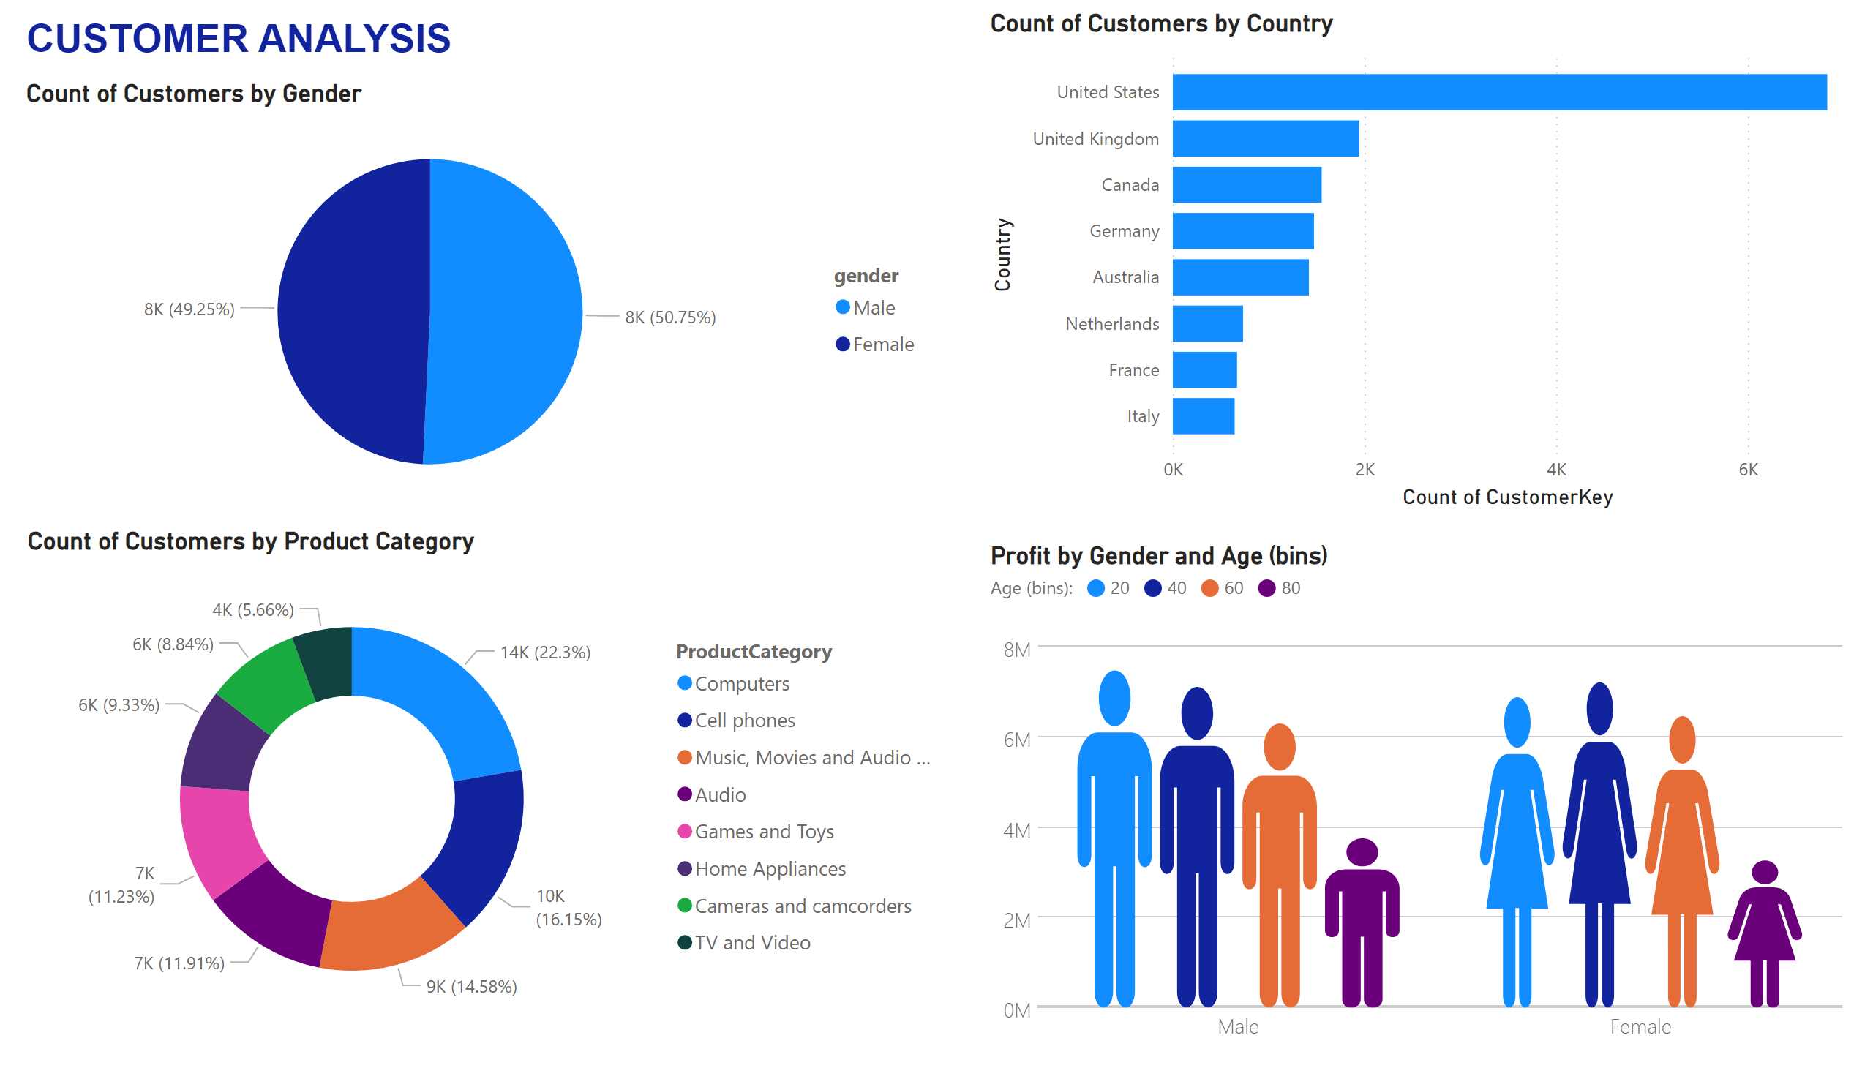
Customer Analysis
Notes:
Profit by Gender and Age (bins)
No alt text provided
Count of Customers by Product Category
No alt text provided
Count of Customers by Gender
No alt text provided
Count of Customers by Country
No alt text provided
textbox
No alt text provided

Slide 4
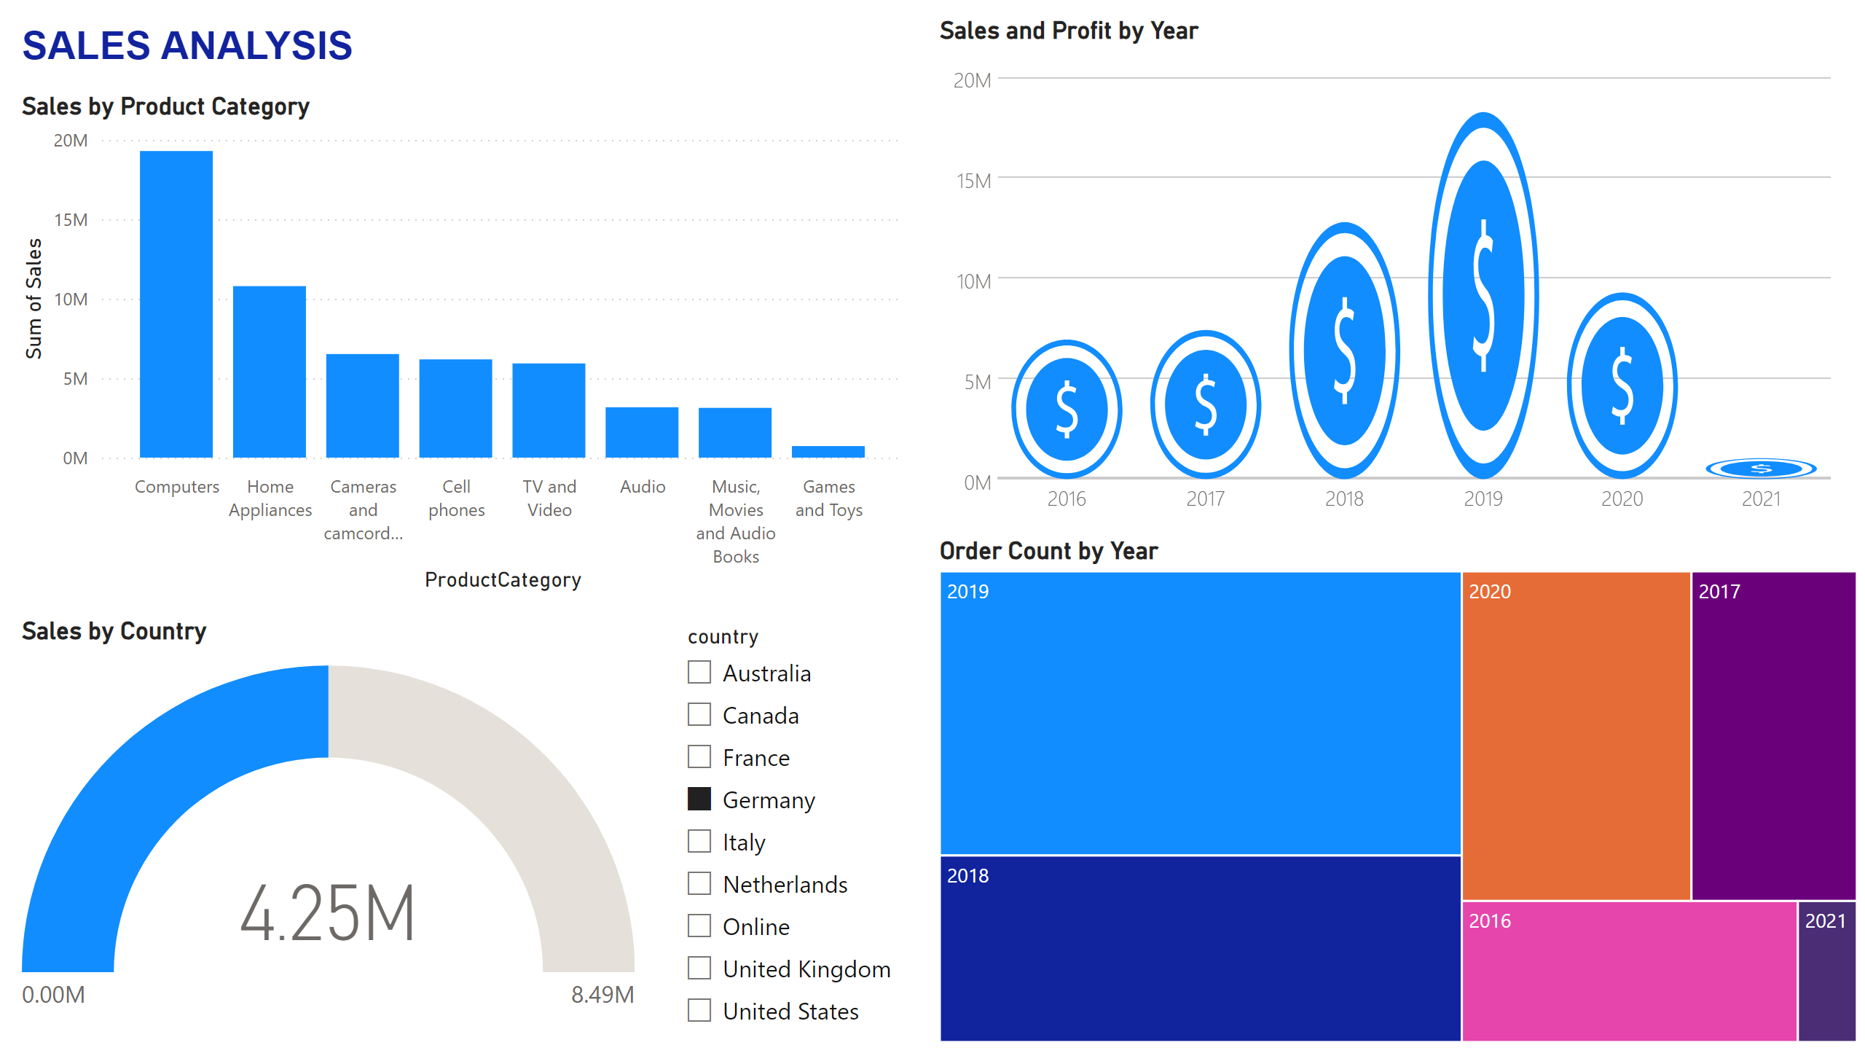
Sales Analysis
Notes:
Sales by Product Category
No alt text provided
Sales and Profit by Year
No alt text provided
Order Count by Year
No alt text provided
Sales by Country
No alt text provided
slicer
No alt text provided
textbox
No alt text provided

Slide 5
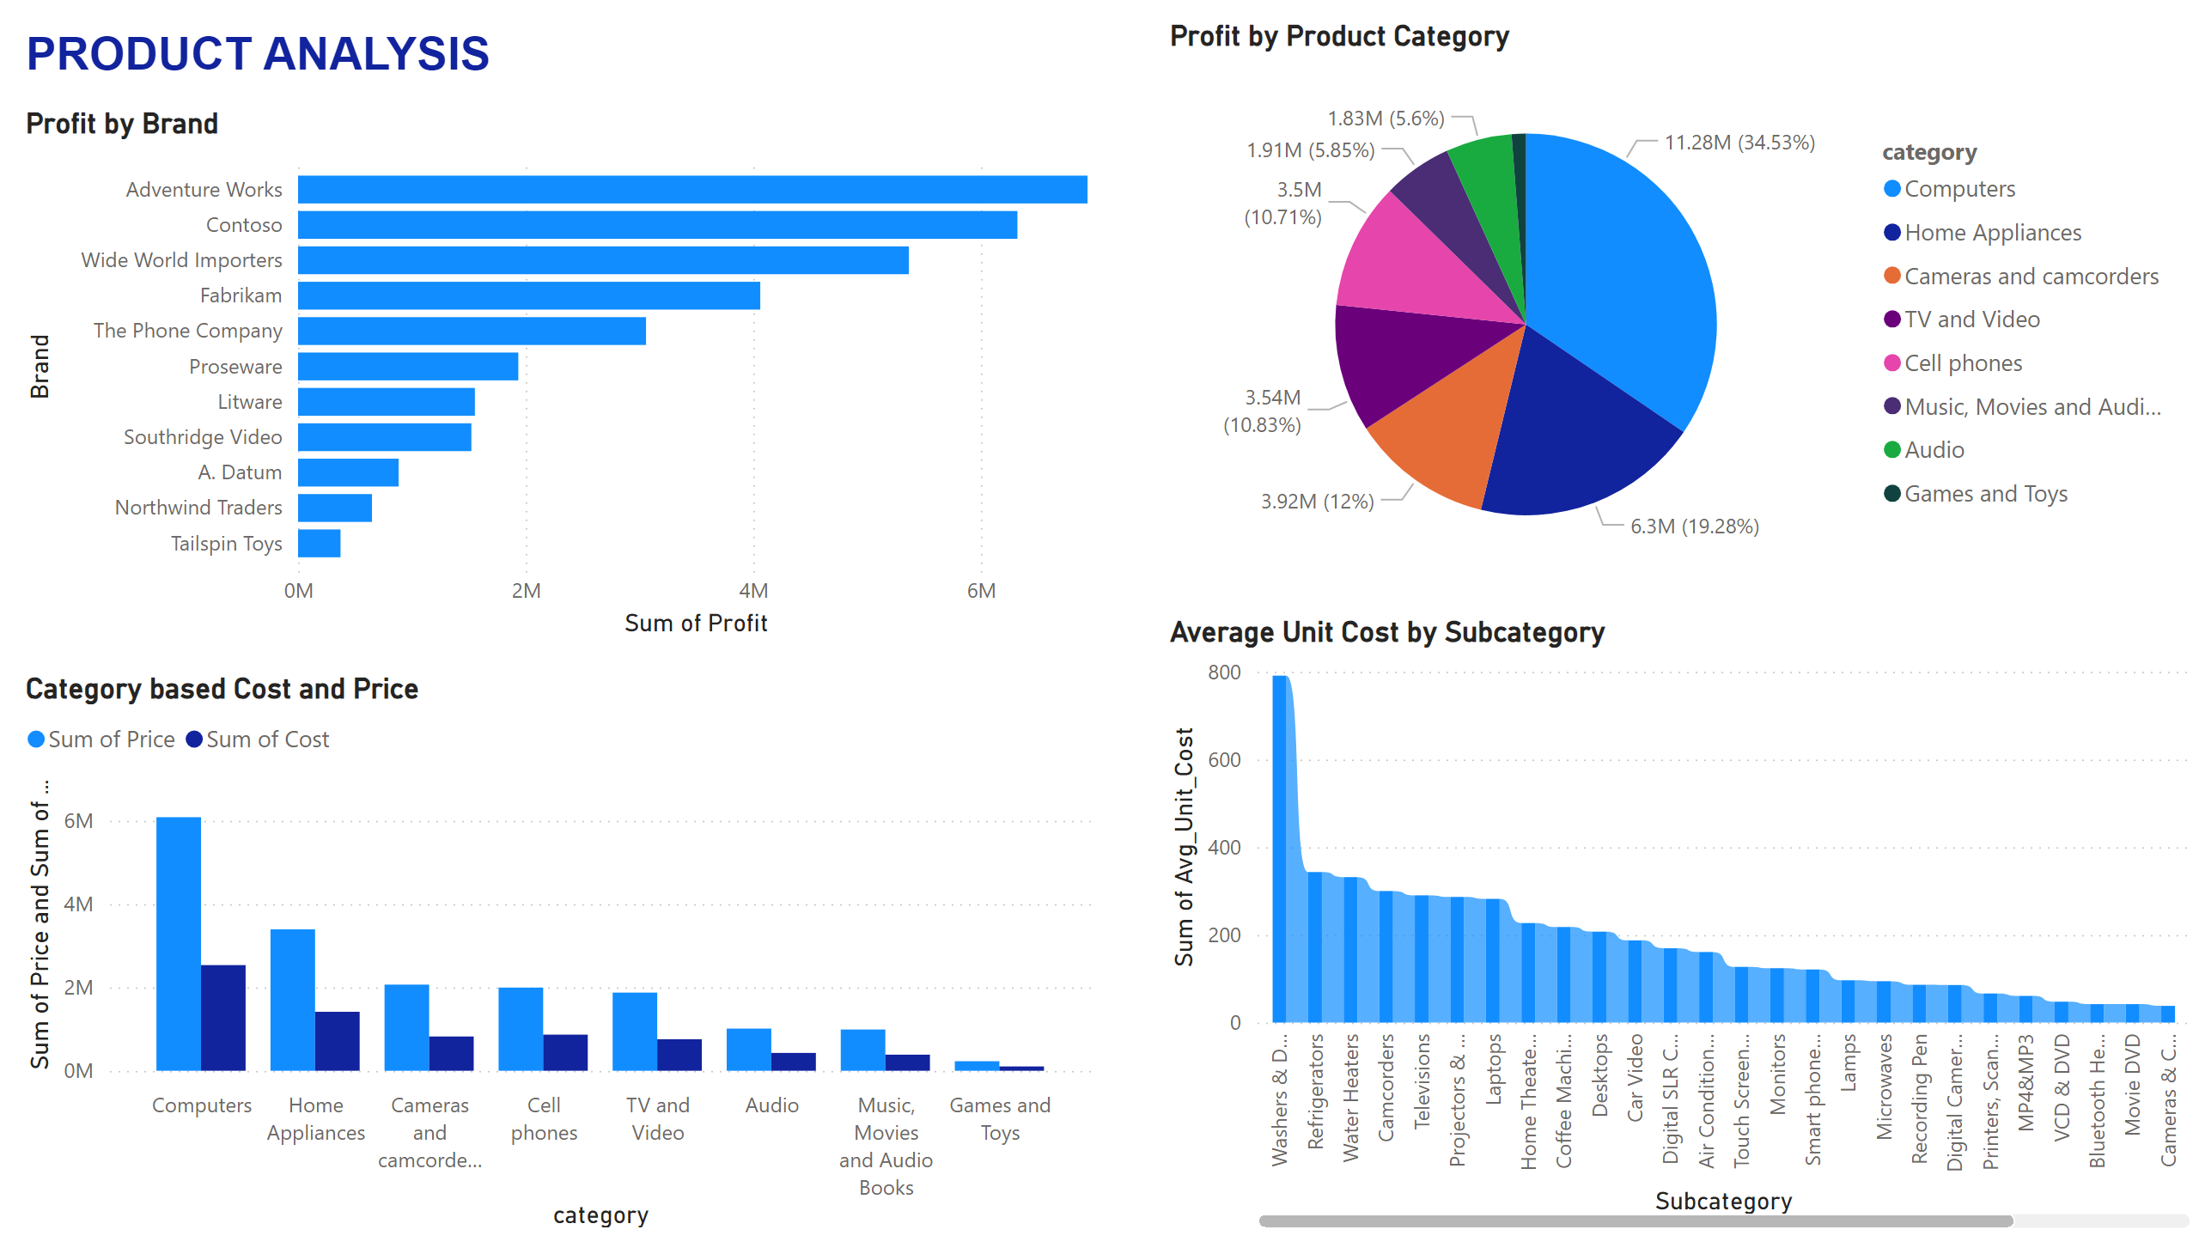
Product Analysis
Notes:
Profit by Brand
No alt text provided
Profit by Product Category
No alt text provided
Category based Cost and Price
No alt text provided
Average Unit Cost by Subcategory
No alt text provided
textbox
No alt text provided

Slide 6
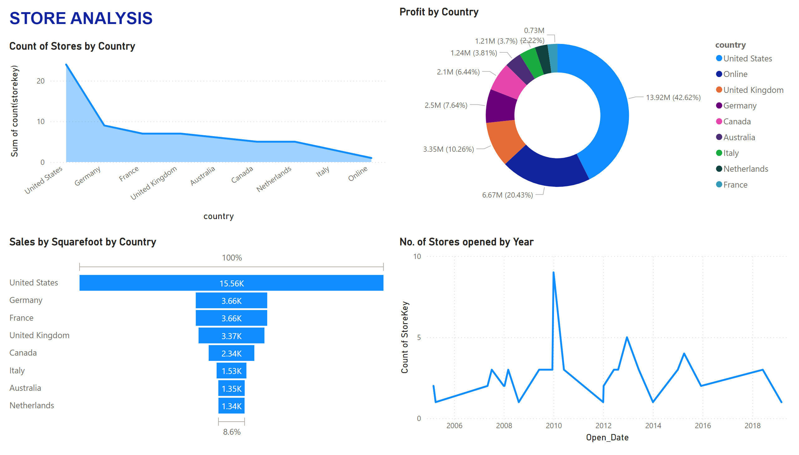
Store Analysis
Notes:
Count of Stores by Country
No alt text provided
Sales by Squarefoot by Country
No alt text provided
Profit by Country
No alt text provided
No. of Stores opened by Year
No alt text provided
textbox
No alt text provided

